Slide 1
Arizona Western College Service Desk
Robert Schroeder – Academic and Administrative Technology Coordinator

Slide 2
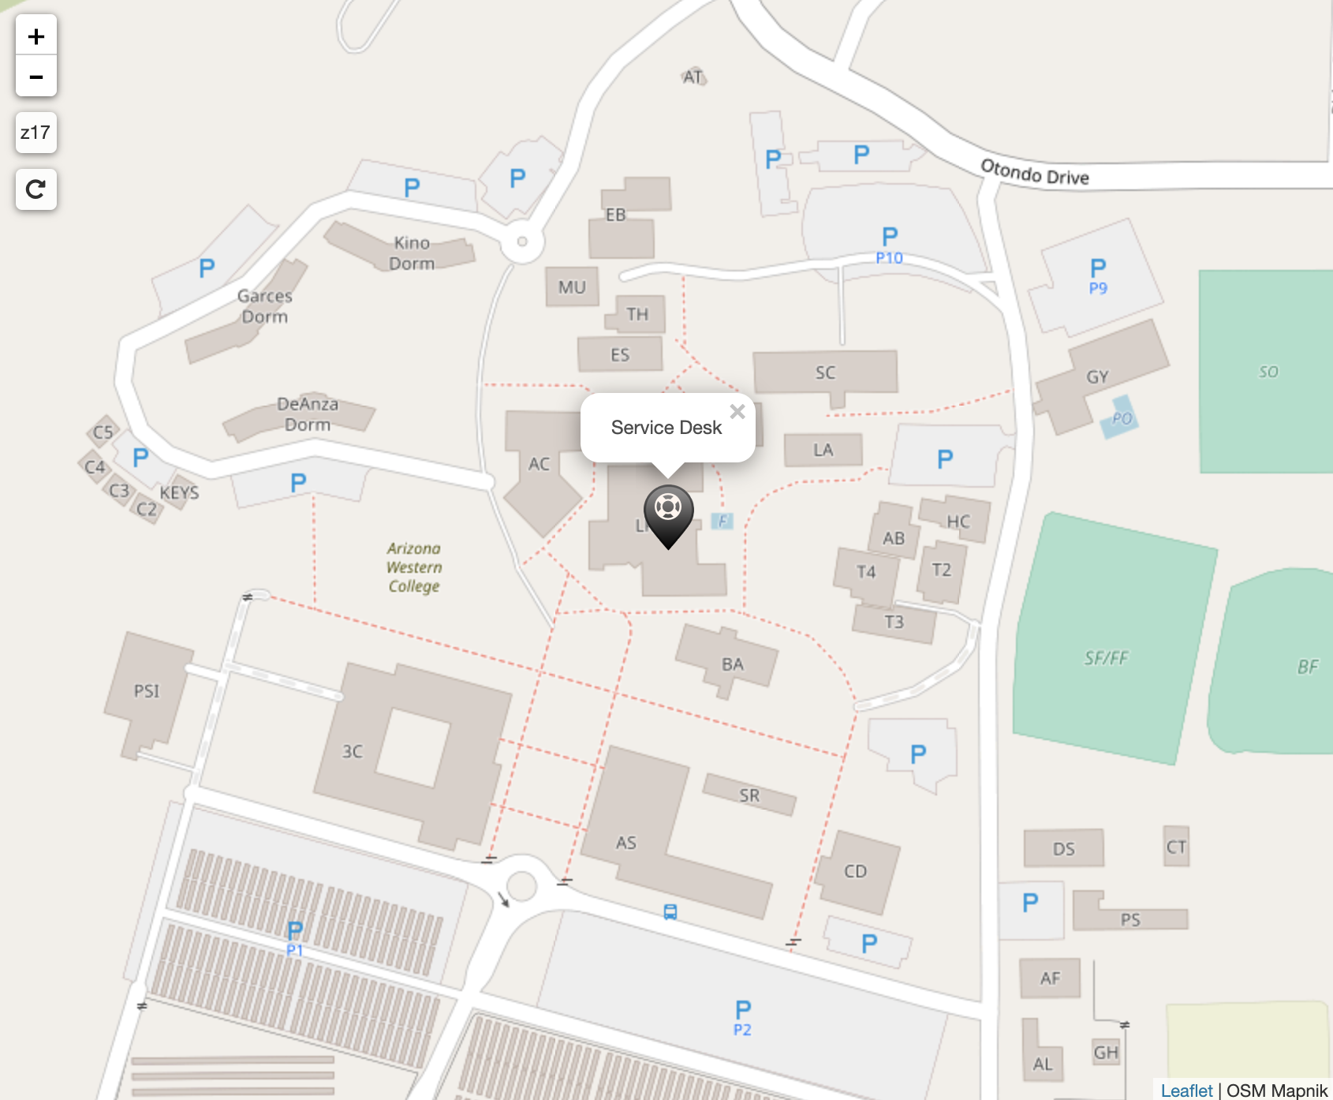
Service Desk – Yuma Campus
Located in the LR building (LR 80)
Hours of operations:
Mon - Thurs
7 am – 5 pm
5 pm – 10 pm (phone support)
Friday
8 am – 4 pm

Slide 3
Service Desk - Requests
How to contact the Service Desk:
Walk-in: LR 80
Phone: 928.317.5892 (ext 75892)
Email: ServiceDesk@azwestern.edu
Web Request: https://www.azwestern.edu/support/help-desk-request
MS Bookings (ITSS – Service Desk – Yuma): https://bit.ly/39ROUpT

Slide 4
Service Desk - Services
Microsoft Office 365
Dashlane Password Manager
Zoom Video Conferencing
Blackboard LMS
And Much More…

Slide 5
Service Desk – M365
Outlook
PowerPoint
Excel
Word
OneNote
Teams
OneDrive
Over 30 apps bundled in M365

Slide 6

Service Desk – More Information
Check our our page on AWC’s website: https://azwestern.edu/support

